Slide 1
Presentation
PROJECT "SUPERSTORE SALES DATASET"
Group D
-Ahmed Hanfi Mahmoud
-Maha Mohamed ElShazly
-Phoebe Issac yassa
-Fareed Mostafa Elserafy
-Mohamed Hamada Abdel-Aty

Slide 2
03
INTRODUCTION
04
DATA SUMMARY
TABLE OF CONTENTS
05
DATA VALIDATION & CLEANING
06
ANALYSIS
07
FORECASTING
08
DASHBOARD
09
RECOMMENDATION

Slide 3

INTRODUCTION
This presentation explores the Superstore Sales dataset, which provides valuable insights into a company's sales performance. The dataset includes columns such as order information, customer details, product details, and sales. Number of Rows: 8399 rows, indicating a relatively large dataset. By analyzing the data, we aim to uncover key trends, identify areas for improvement, and support data-driven decision-making.

Slide 4

DATA SUMMARY
key statistics about the dataset:
3 tables orders, users and returns
order table:
Number of Rows: 8399
Number of columns: 23
Data Types: The columns have a mix of data types, including numeric (e.g., Row ID, Sales), categorical (e.g., Ship Mode, Customer Segment, Country, City, State, Product Category, Sub-Category), and datetime (e.g., Order Date).

Slide 5
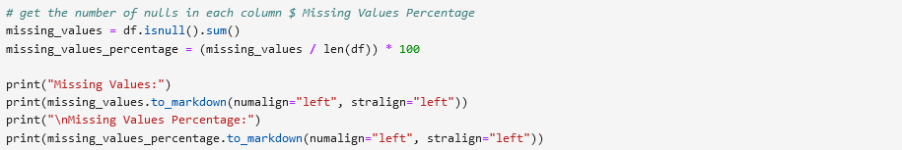
DATA VALIDATION & CLEANING
The Impact of Data Quality on Analysis can be summarized in that quote
"If you input incorrect or incomplete data, you'll get incorrect or incomplete results."
so, we make Data Validation & Cleaning into several Steps:
1- Missing Values:

Slide 6
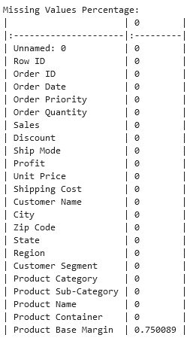
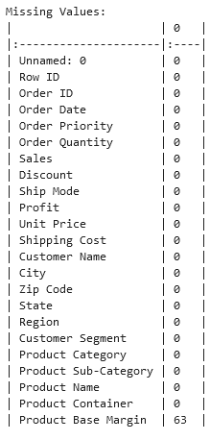
DATA VALIDATION & CLEANING

Slide 7
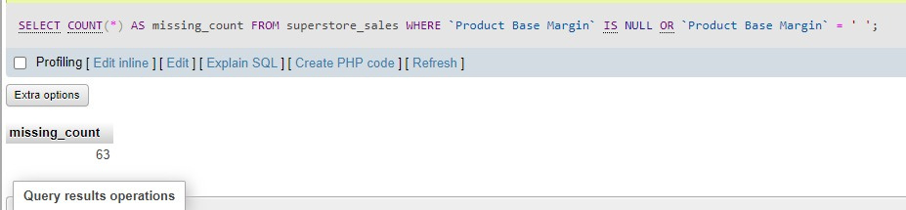
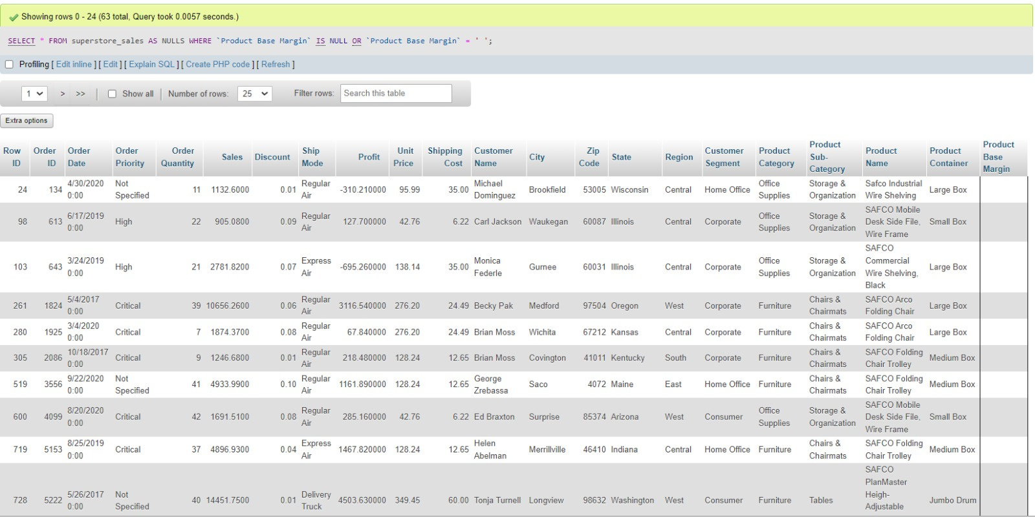
DATA BASE & SQL

Slide 8
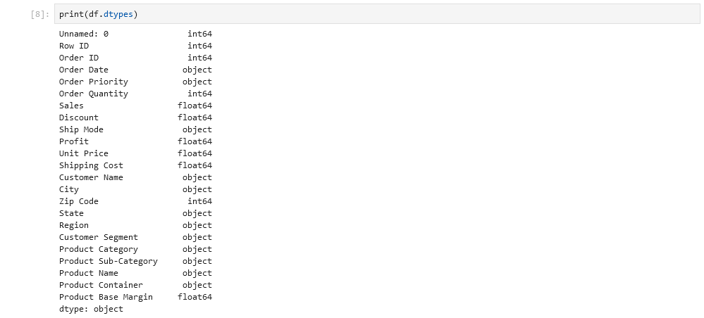
DATA VALIDATION & CLEANING
2- Handling Missing Values:
3- Data Types:

Slide 9
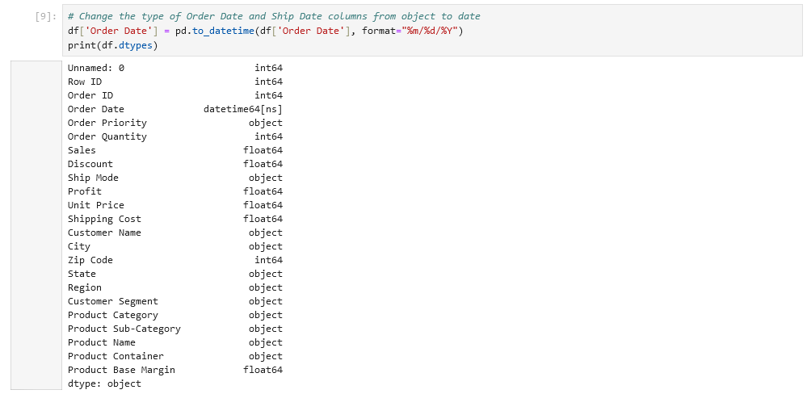
DATA VALIDATION & CLEANING
4- Correcting Data Types:

Slide 10
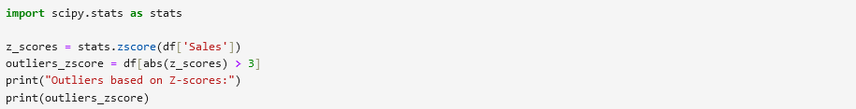
DATA VALIDATION & CLEANING
5- Duplicate Rows:
6- Outlier Detection:
1- Z-Scores
Definition: A Z-score measures how many standard deviations a data point is from the mean.
Calculation:
Z-score = (data point - mean) / standard deviation
Outlier Identification: Points with Z-scores greater than a threshold (e.g., 3 or 2) are often considered outliers.

Slide 11
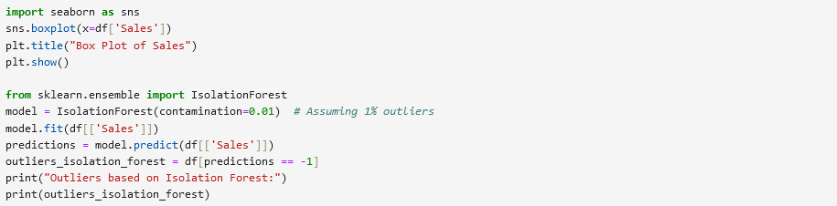
DATA VALIDATION & CLEANING
Outlier Detection:
2- Isolation Forest
Definition: An unsupervised anomaly detection algorithm that isolates outliers in a tree-based structure.
How it works:
a- Randomly selects features and splits the data into subspaces.
b- Outliers are identified as points that are isolated in fewer splits than normal points.

Slide 12
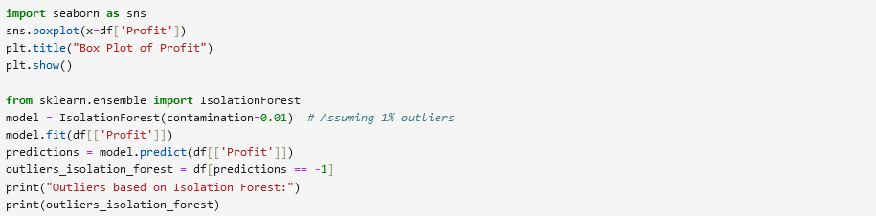
DATA VALIDATION & CLEANING

Slide 13
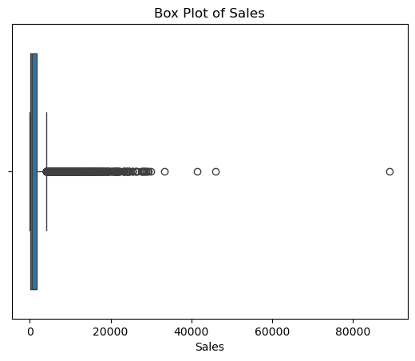
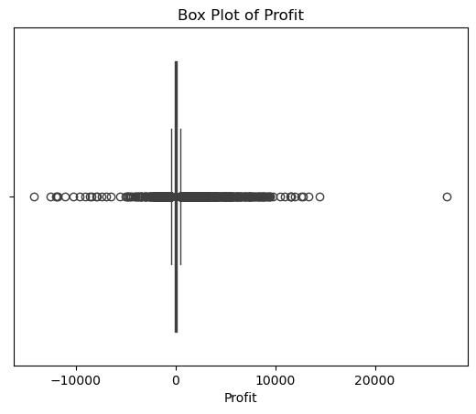
DATA VALIDATION & CLEANING

Slide 14
DATA QUALITY ASSESSMENT
The final state of the dataset after cleaning:
1- Orders table
Number of rows and columns after cleaning "8399 rows × 23 columns"
Percentage of missing values after imputation "0" records.
Duplicated values is zero records.
number of outlier is 208 rows
2- Users table
Number of rows and columns 9 rows × 2 columns
3- Returns table
Number of rows and columns 573 rows × 2 columns

Slide 15
ANALYSIS
SALES AND RETURNS ANALYSIS
Return Rate Analysis:
What are the total sales and the sales of returned orders?
What is the percentage of return profits out of the total profits?
Category Sales Analysis:
What are the total sales for each category?
What are the sales of returned orders in each category?
What are the sales after deducting returned sales in each category?
What is the return rate in each category?
MONTHLY SALES BY CATEGORY:
WHAT ARE THE MONTHLY SALES FOR EACH CATEGORY?
SHIPPING COST ANALYSIS:
IMPACT OF SHIPPING COSTS ON PROFITS:
WHAT ARE THE SHIPPING COSTS AND THEIR IMPACT ON PROFITS FOR EACH CATEGORY?

Slide 16
ANALYSIS
PROFIT ANALYSIS
Category Profit Analysis:
What are the total profits for each category?
What are the net profits after deducting returns for each category?
Regional Profit Analysis:
What are the total profits for each category in each region?
REGIONAL SALES ANALYSIS:
What are the total sales for each category in each region?
SUB-CATEGORY ANALYSIS
What are the sales and profits for each sub-category?
Customer Segment Analysis
Which customer segments have the highest sales and profits in each category?
Which sub-categories have the highest sales and profits within each category?

Slide 17
ANALYSIS
TOP CITIES BY SALES AND PROFITS:
What are the sales and profits for the top ten cities?
Top states by Sales and Profits:
What are the sales and profits for the top ten states?
CONTAINER TYPE ANALYSIS:
What are the sales and profits for each type of product container?
"FORCASTING QUESTIONS :
TOTAL SALES AND PROFITS FOR THE NEXT SIX MONTHS?
TOTAL SALES FOR EACH PRODUCT CATEGORY FOR THE NEXT SIX MONTHS?
PROFITS FOR EACH PRODUCT CATEGORY FOR THE NEXT SIX MONTHS?
TOTLA SALES AND PROFITS FOR EACH REGION FOR THE NEXT SIX MONTHS?

Slide 18
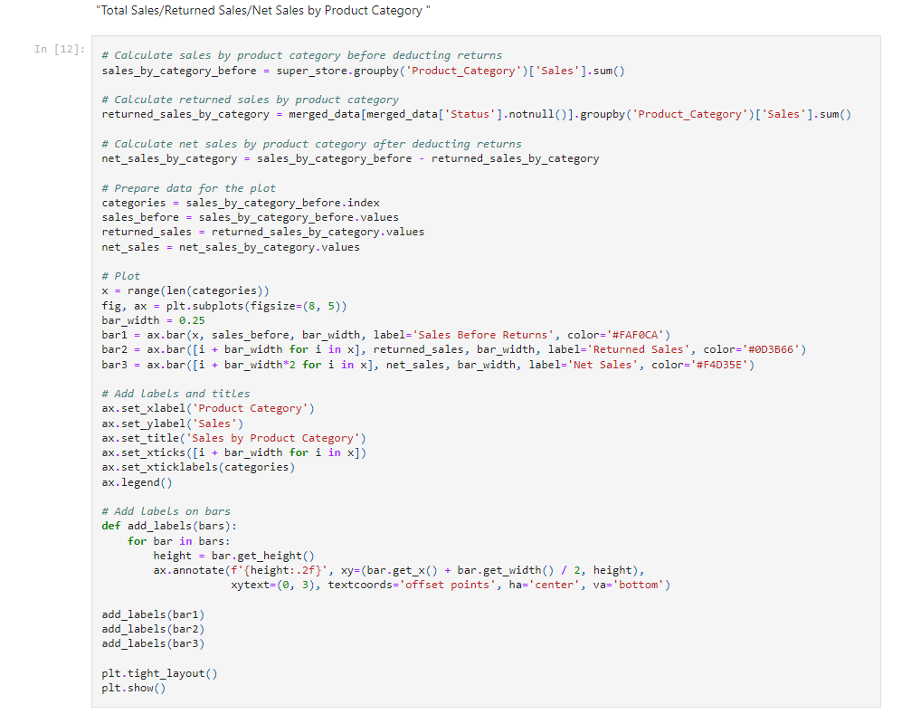
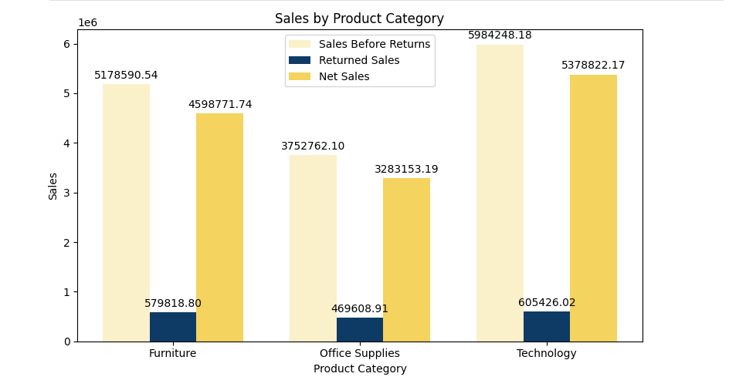
ANALYSIS
"TOTAL SALES&RETURNED SALES&NET SALES BY PRODUCT CATEGORY

Slide 19
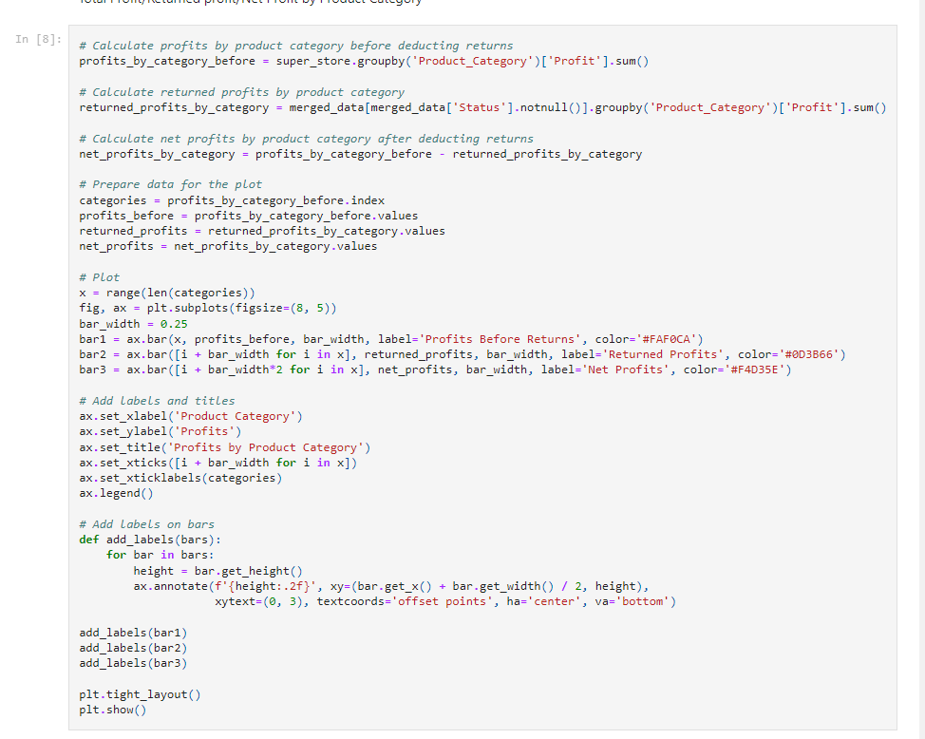
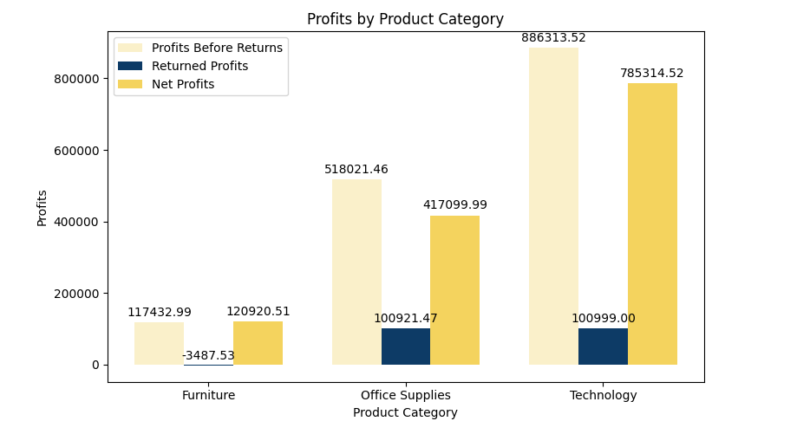
ANALYSIS
"TOTAL PROFIT & RETURNED PROFIT & NET PROFIT BY PRODUCT CATEGORY "

Slide 20
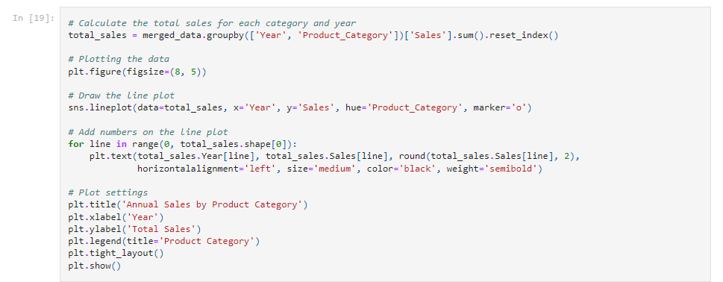
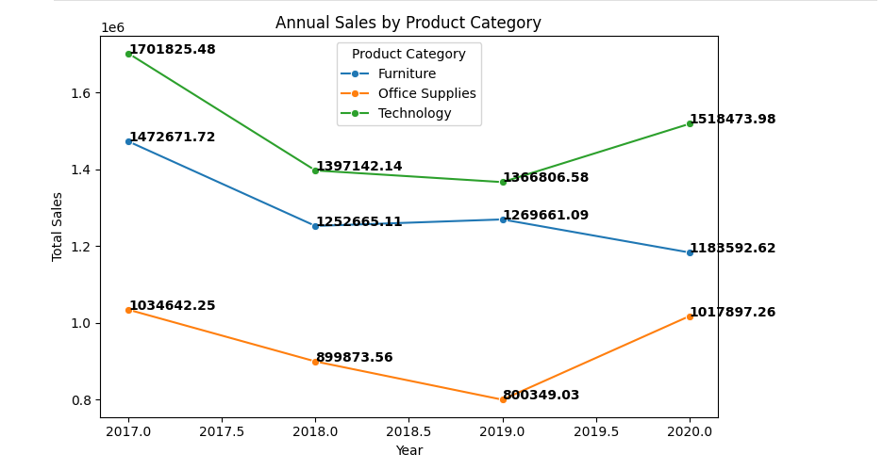
ANALYSIS
ANNUAL SALES BY PRODUCT CATEGORY

Slide 21
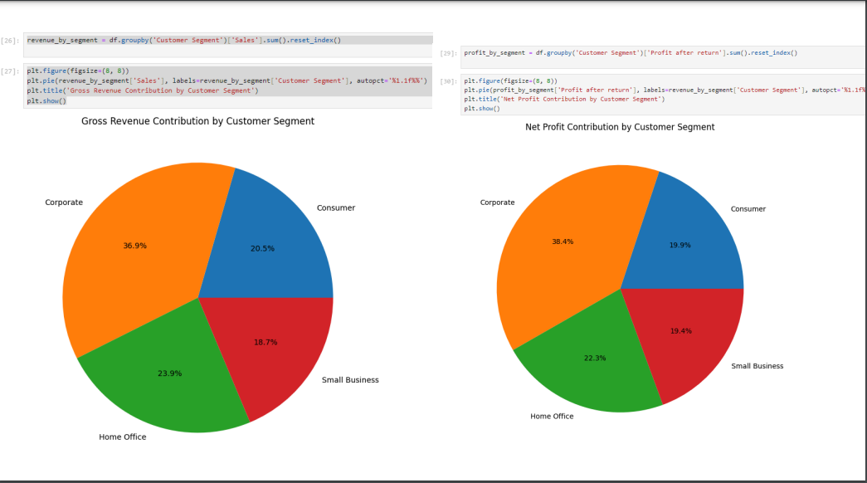
ANALYSIS
"CONTRIBUTION OF SALES & PROFIT BY CUSTOMER SEGMENT"

Slide 22
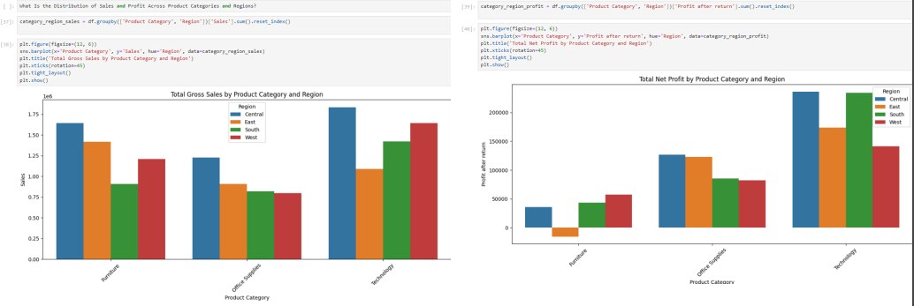
ANALYSIS
"SALES & NET PROFIT IN REGIONS BY PRODUCT CATEGORY"

Slide 23
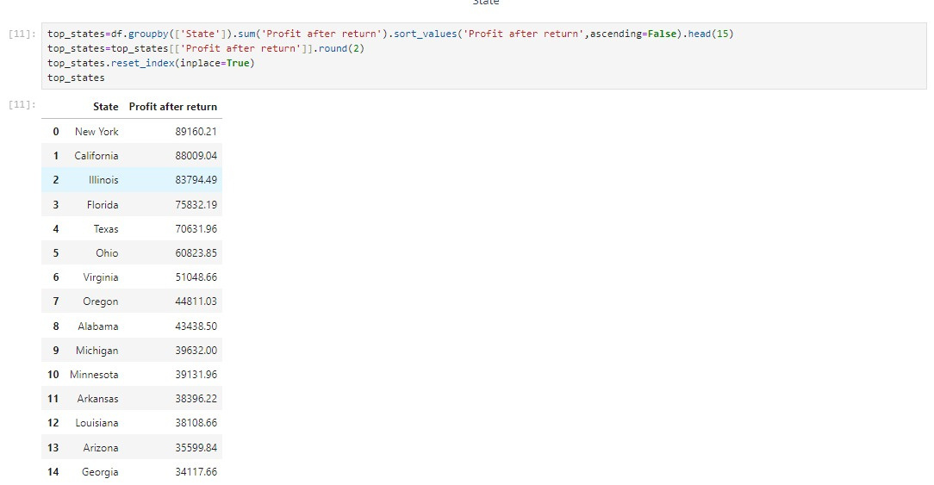
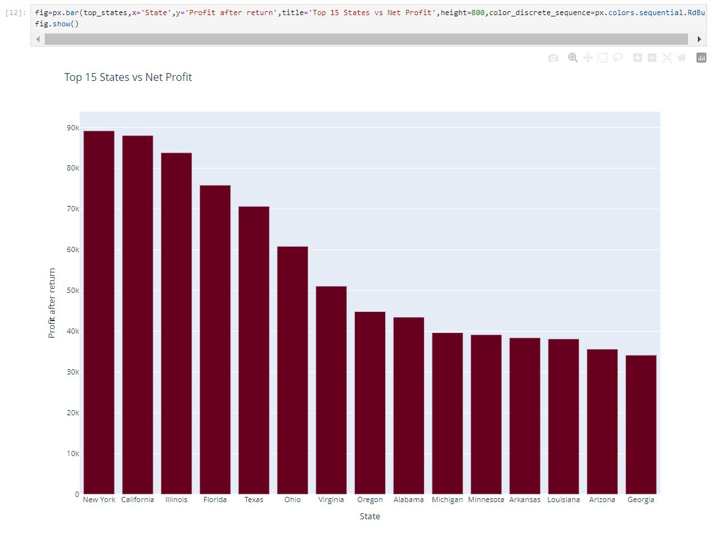
ANALYSIS
"TOP 15 STATES BY PROFIT"

Slide 24
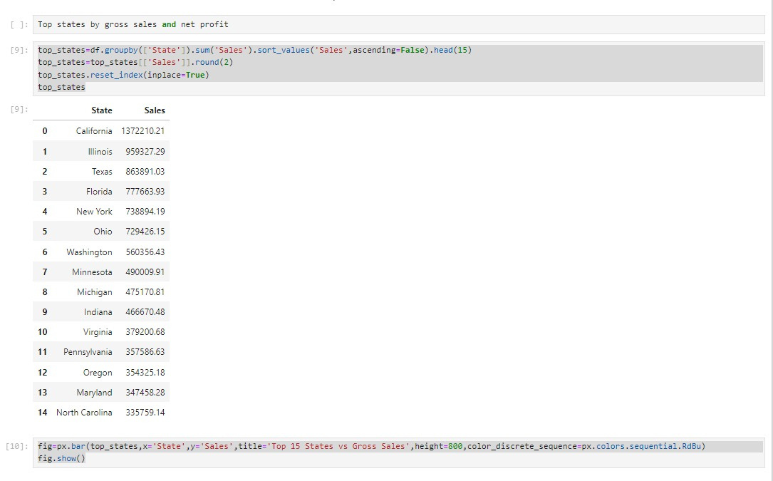
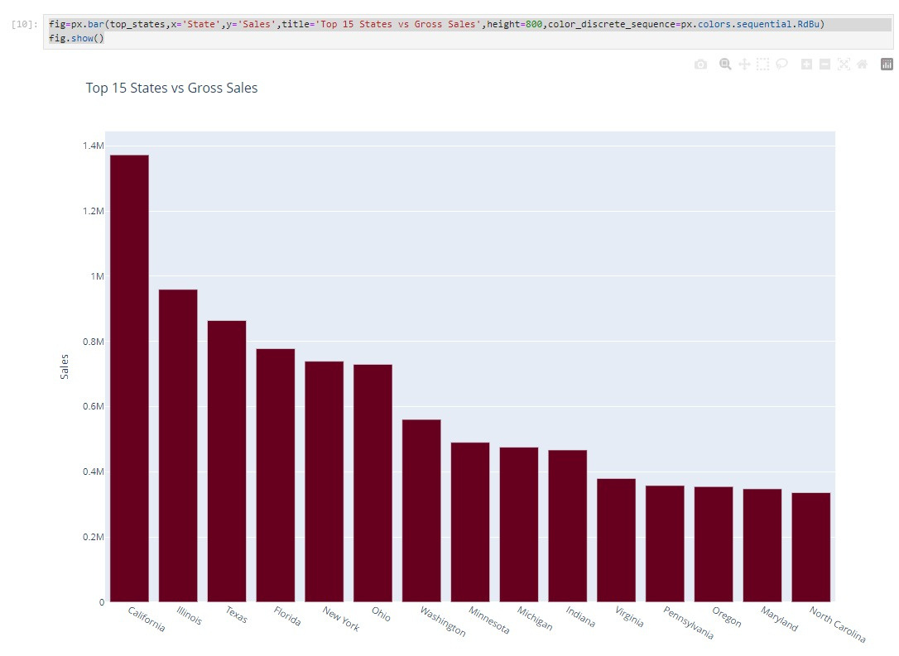
ANALYSIS
"TOP 15 STATES BY SALES"

Slide 25
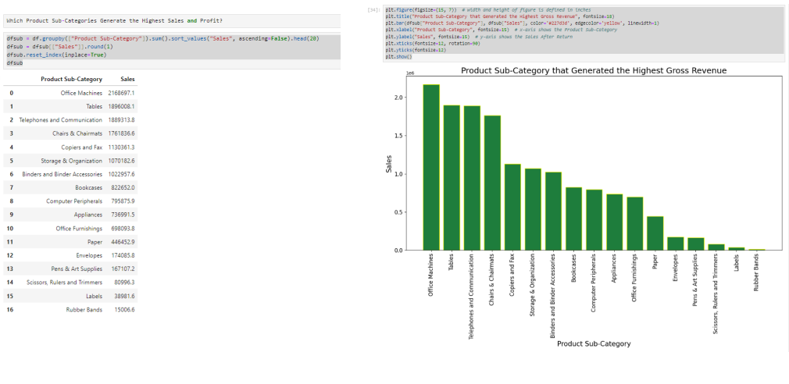
ANALYSIS
"SALES BY PRODUCT SUB-CATEGORY"

Slide 26
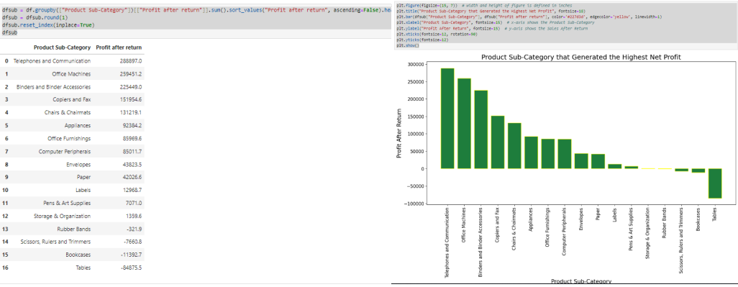
ANALYSIS
"NET PROFIT BY PRODUCT SUB-CATEGORY"

Slide 27
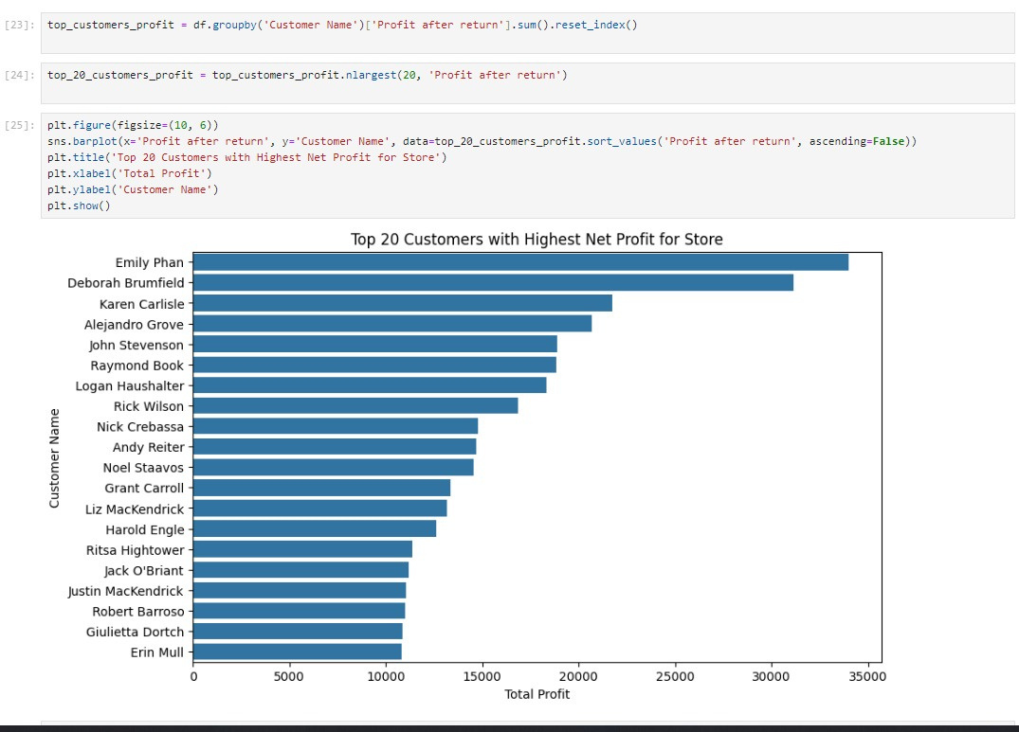
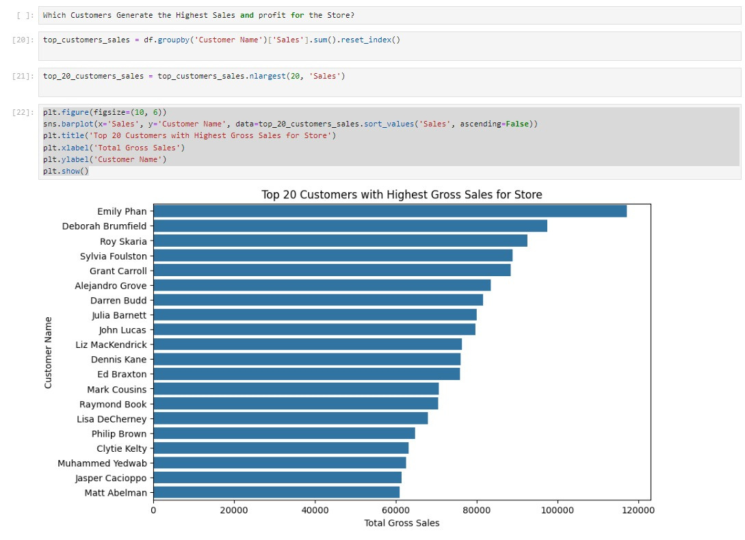
ANALYSIS
TOP 20 CUSTOMERS BY TOTAL SALES & NET PROFIT

Slide 28
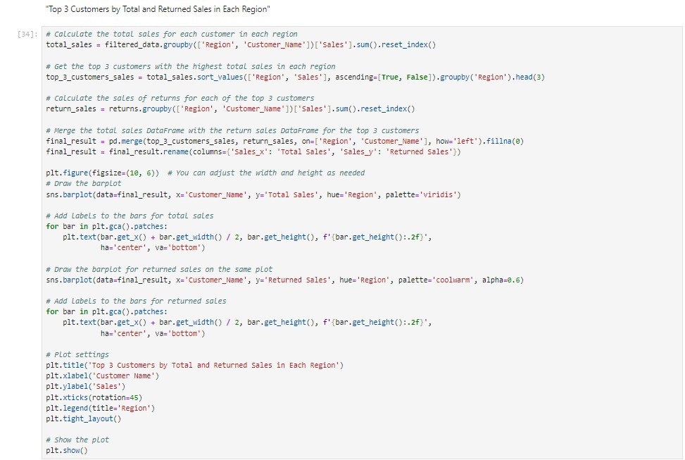
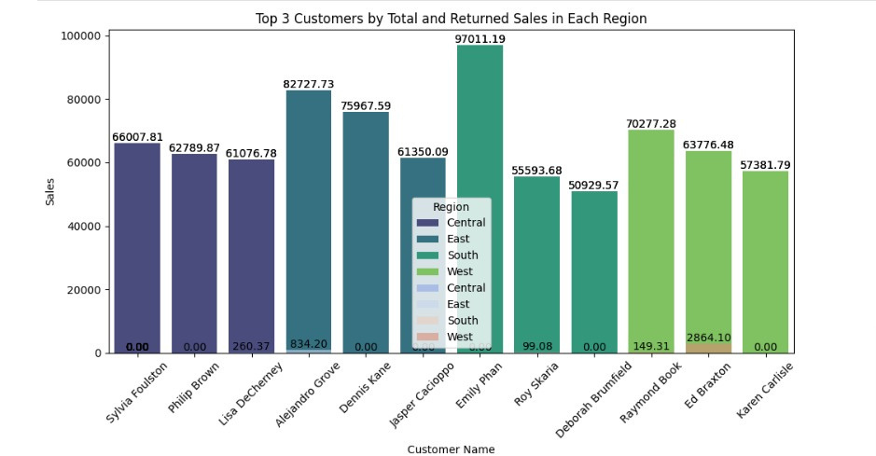
ANALYSIS
"TOP 3 CUSTOMERS BY TOTAL AND RETURNED SALES IN EACH REGION"

Slide 29
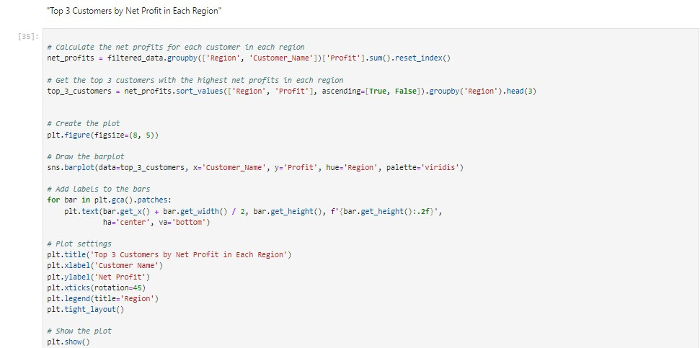
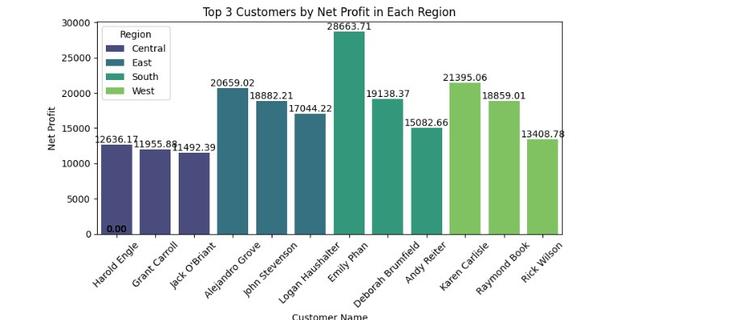
ANALYSIS
"TOP 3 CUSTOMERS BY NET PROFIT IN EACH REGION"

Slide 30
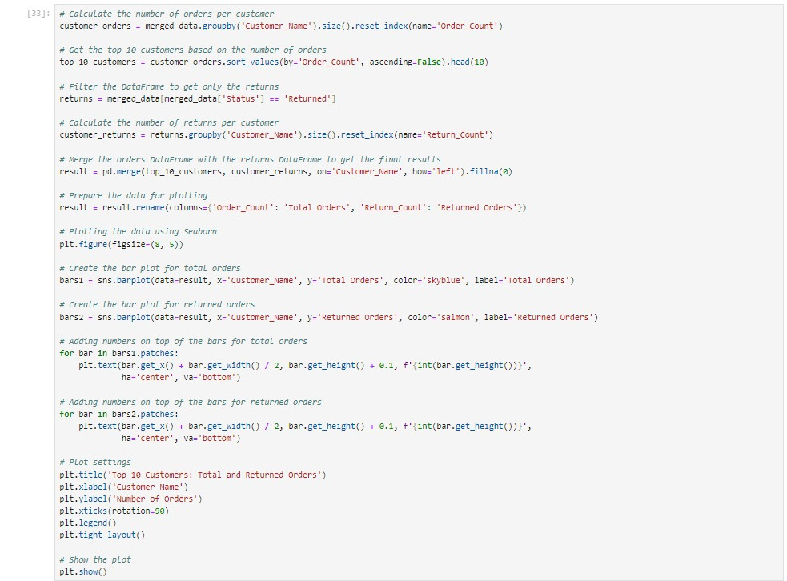
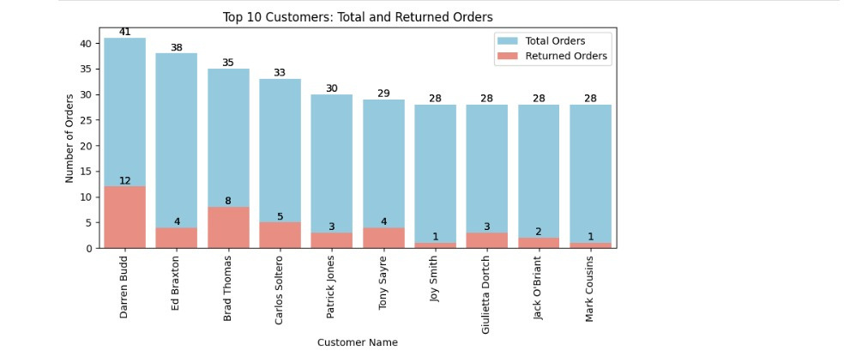
ANALYSIS
TOP 10 CUSTOMERS: TOTAL AND RETURNED ORDERS

Slide 31
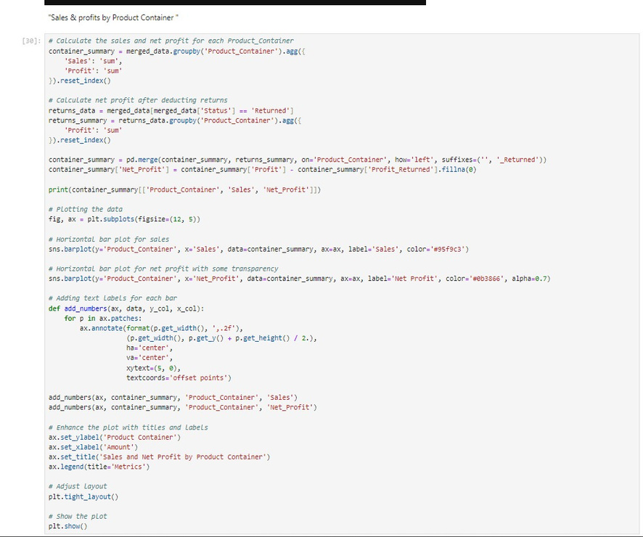
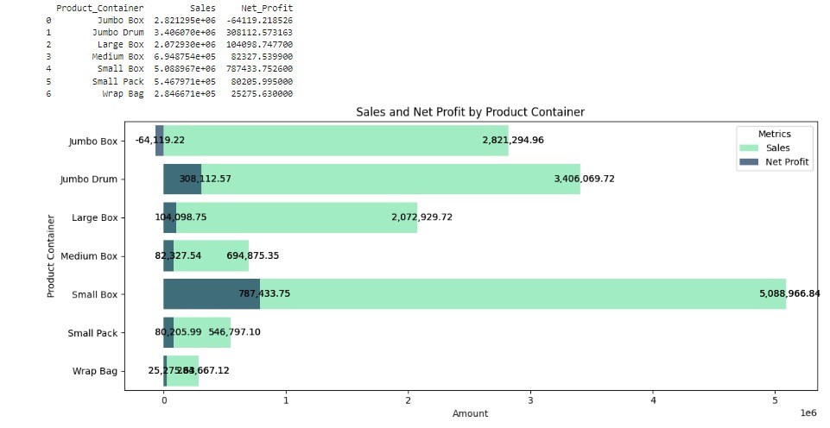
ANALYSIS
"SALES & PROFITS BY PRODUCT CONTAINER"

Slide 32
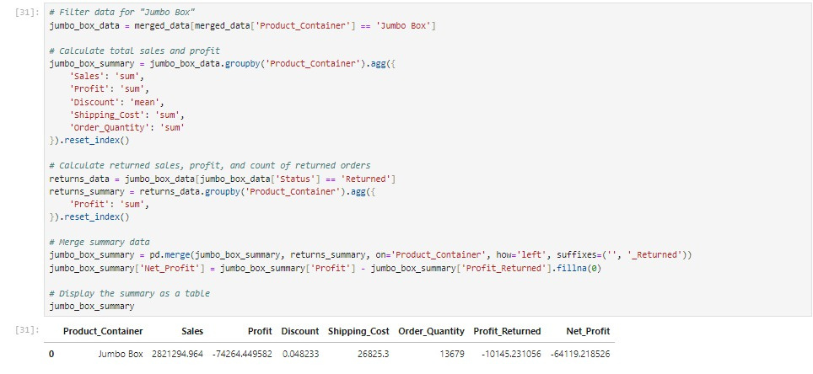
ANALYSIS
JUMBO BOX SUMMARY

Slide 33
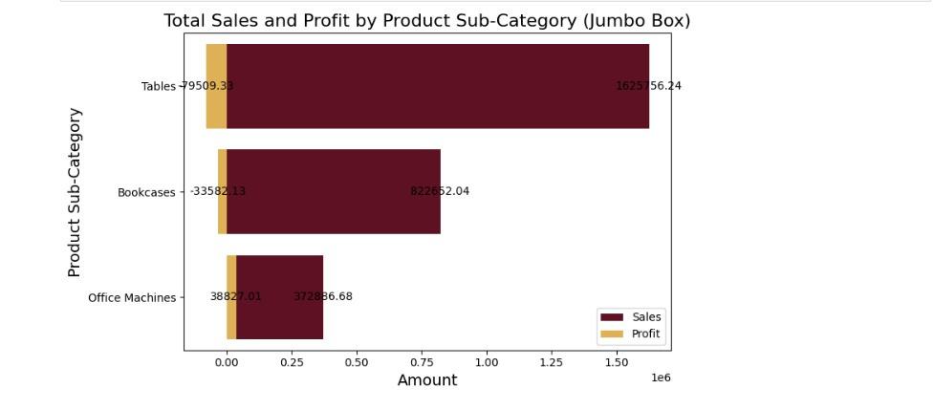
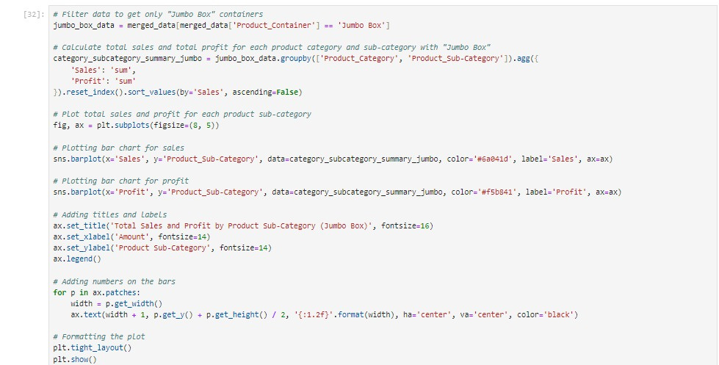
ANALYSIS
TOTAL SALES AND PROFIT BY PRODUCT SUB-CATEGORY (JUMBO BOX)

Slide 34
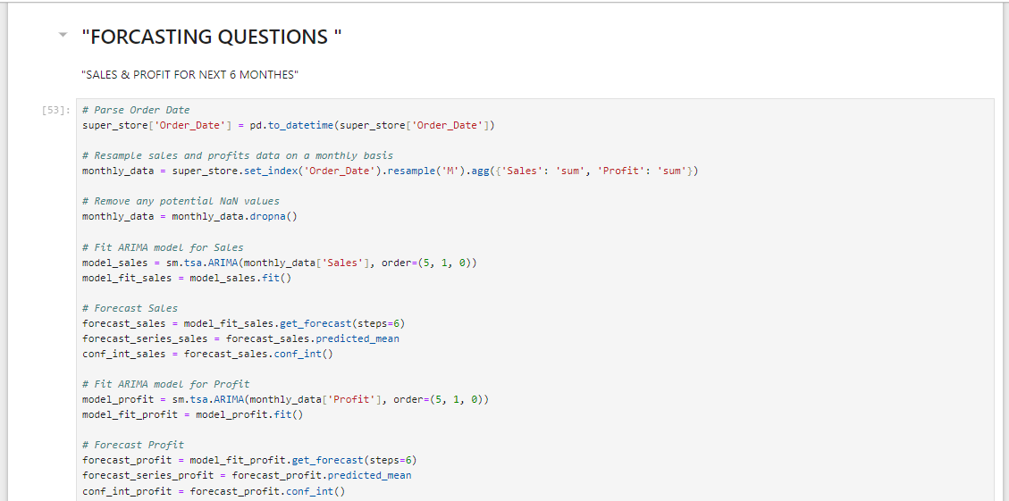
FORECASTING

Slide 35
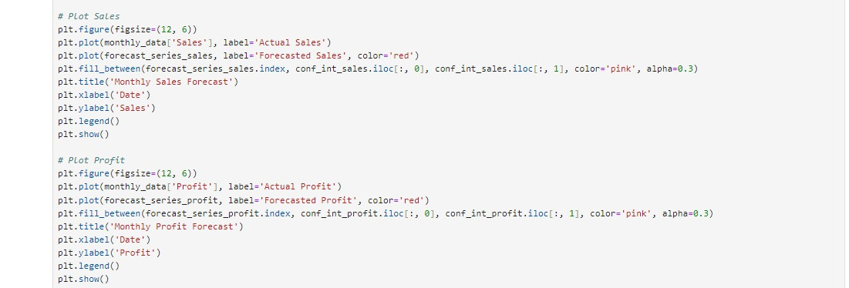
FORECASTING

Slide 36
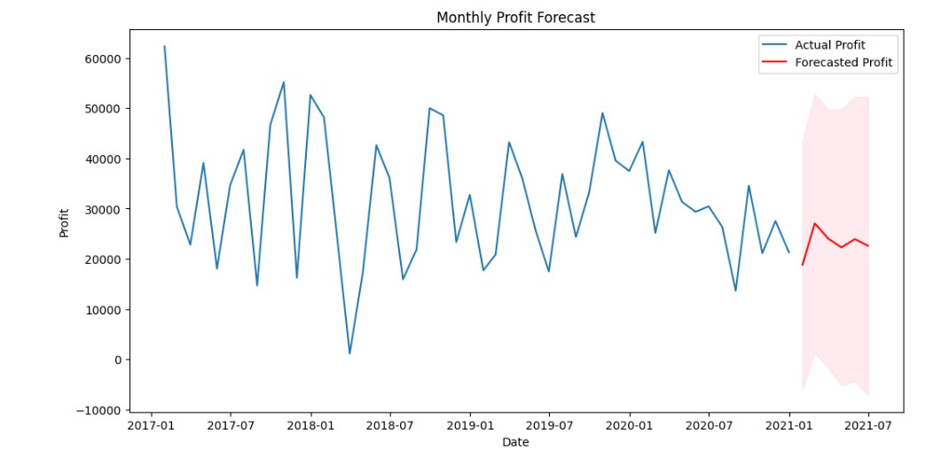
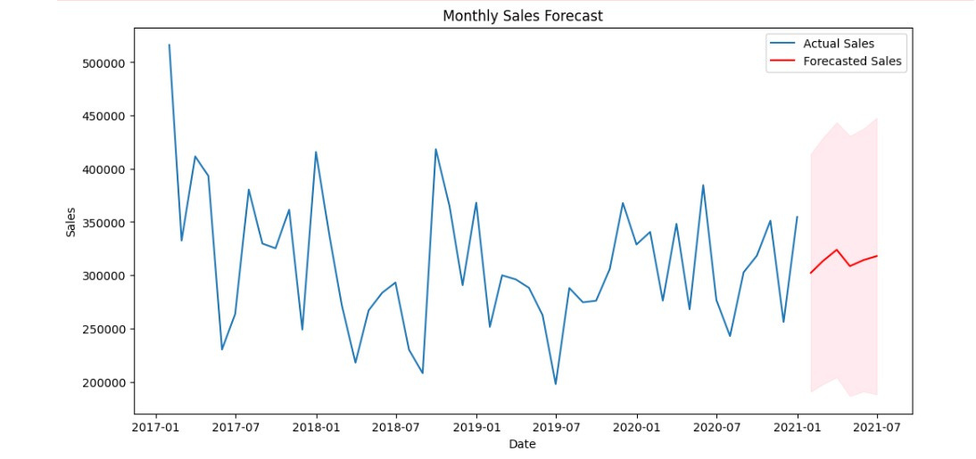
FORECASTING

Slide 37
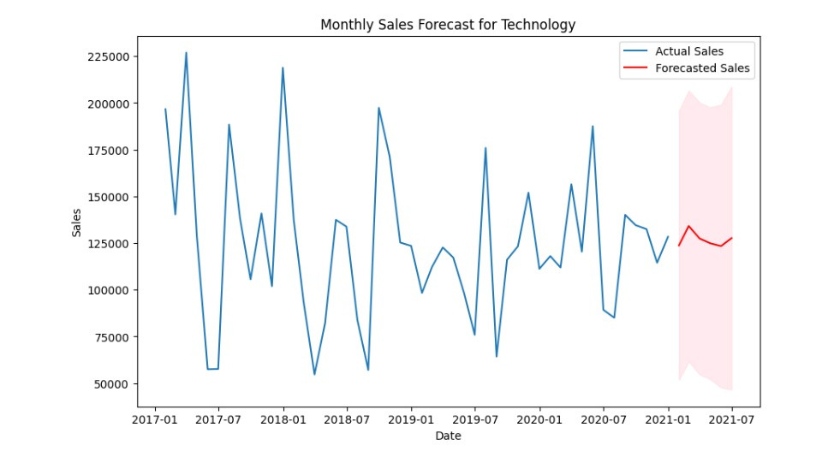
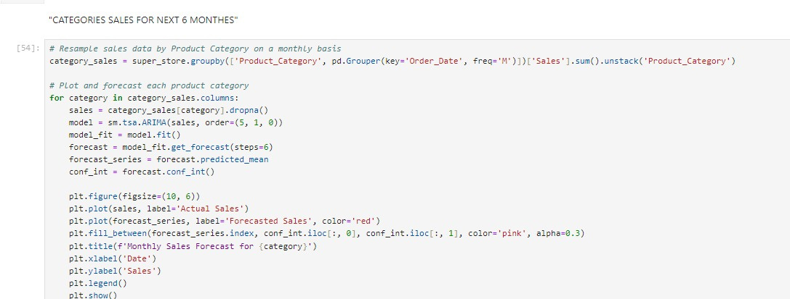
FORECASTING

Slide 38
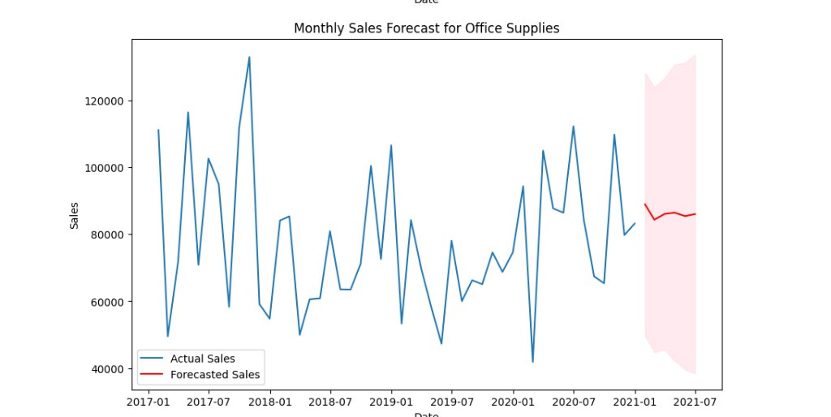
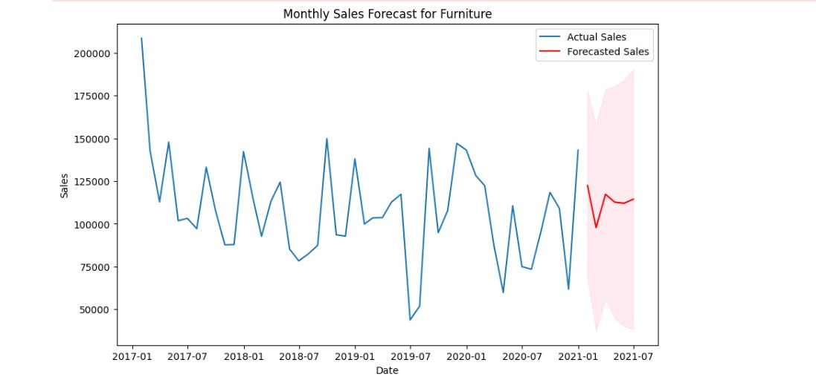
FORECASTING

Slide 39
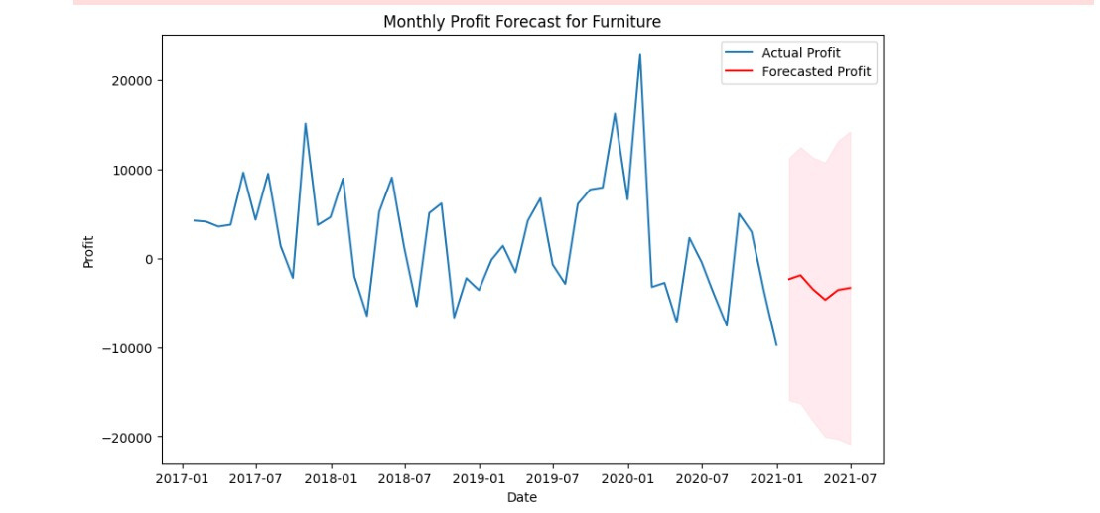
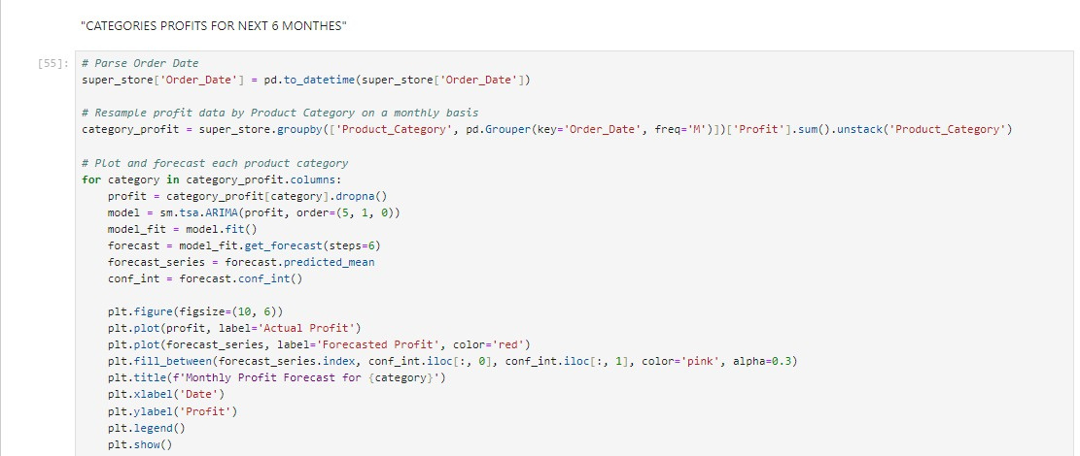
FORECASTING

Slide 40
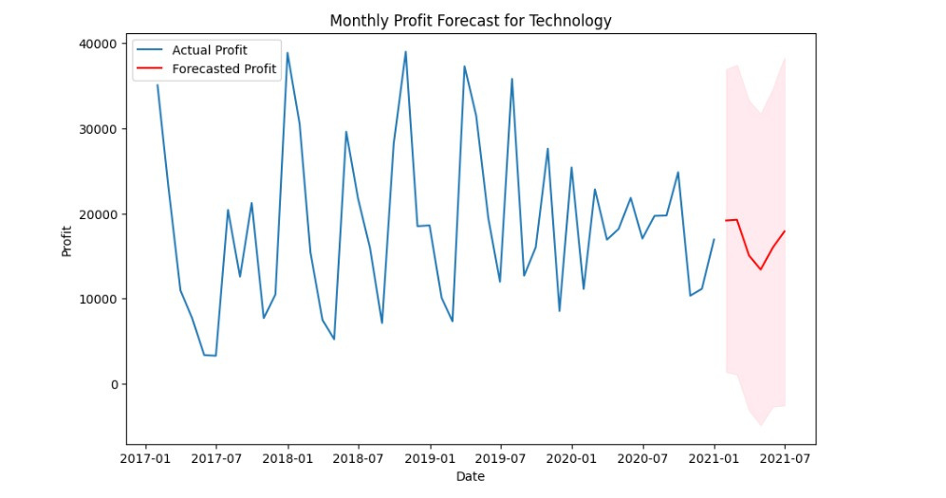

FORECASTING

Slide 41

FORECASTING

Slide 42


FORECASTING

Slide 43


FORECASTING

Slide 44


FORECASTING

Slide 45


FORECASTING

Slide 46

DASHBORD

Slide 47


SUPER STORE SALES RECOMMENDATIONS REPORT

Slide 48
Overviw
This report provides insights and recommendations based on the analysis of Super Store sales data. The data encompasses various aspects of sales performance, including product categories, regional performance, and customer segments. The goal is to identify key trends and opportunities to enhance profitability and efficiency.

Slide 49



Product Categories
Technology
2. Office Communication Devices

Slide 50
Performance Analysis
Analyze Performance by Region and Category

Slide 51
Marketing Strategies
Develop Customized Marketing Strategies
2. Targeted Marketing

Slide 52
Product Development
Develop New Products

Slide 53
Recommendations
Improve Product Quality
Expand Product Range
Optimize Regional Strategies
Enhance Marketing Efforts
Increase Operational Efficiency
Focus on High-Margin Products

Slide 54
Conclusion
The analysis highlights significant opportunities to enhance Super Store's sales performance and profitability. By focusing on high-performing categories, optimizing regional strategies, and enhancing product offerings, Super Store can achieve sustained growth and improved customer satisfaction.

Slide 55
THANKS

